Slide 1
Dead Reckoning with the NXT
By: Stephen Smith

Slide 2
Differential Drive Algorithm
Distance – The distance traveled along the path
RightNew/LeftNew – Tachometer Reading at time n
RightOld/LeftOld – Tachometer Reading at time (n-1)
dtheta – calculated change in theta
theta – direction of forward facing
r- radius of turn
Time steps are 500ms
Track and wheelbase - the width and length of the robot respectively

Slide 3
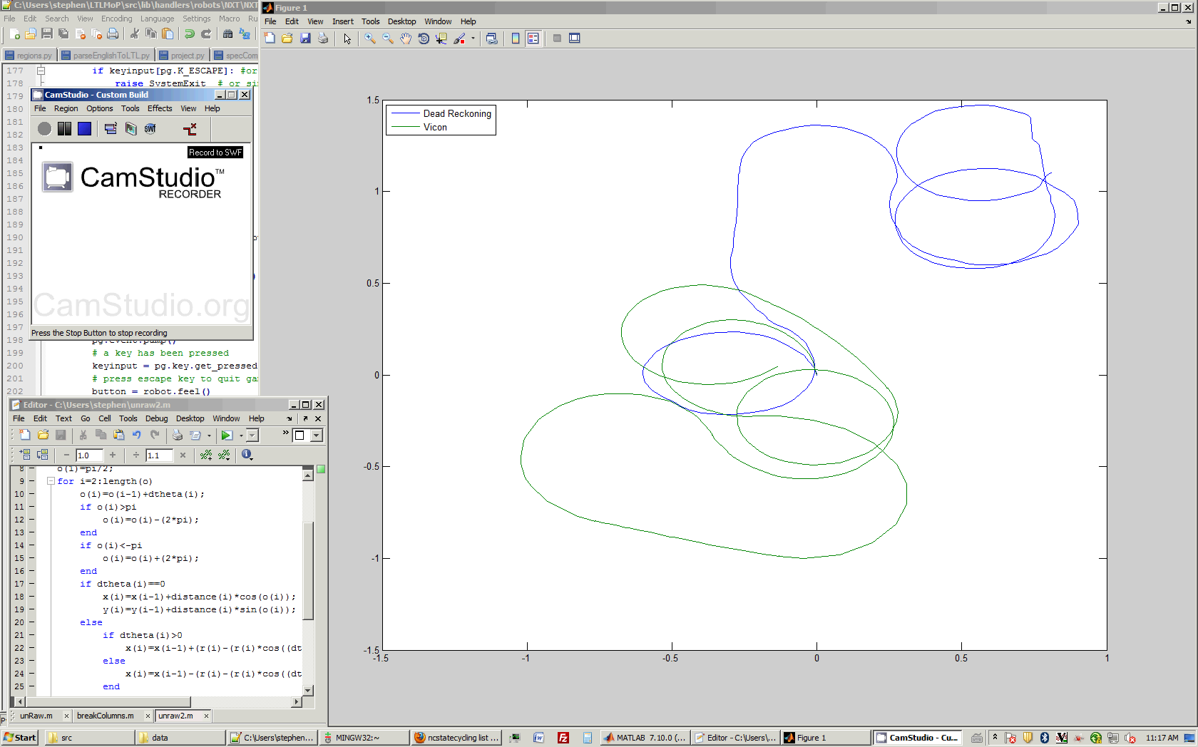
Differential Style Robot

Slide 4



Car Algorithm
Distance – distance traveled along path
r- radius of turn
New/Old – the tachometer readings at time step n and (n-1) respectively
steerAngle – the angle of the front wheels relative to center
Track and wheelbase - the width and length of the robot respectively
Time steps every 500ms

Slide 5
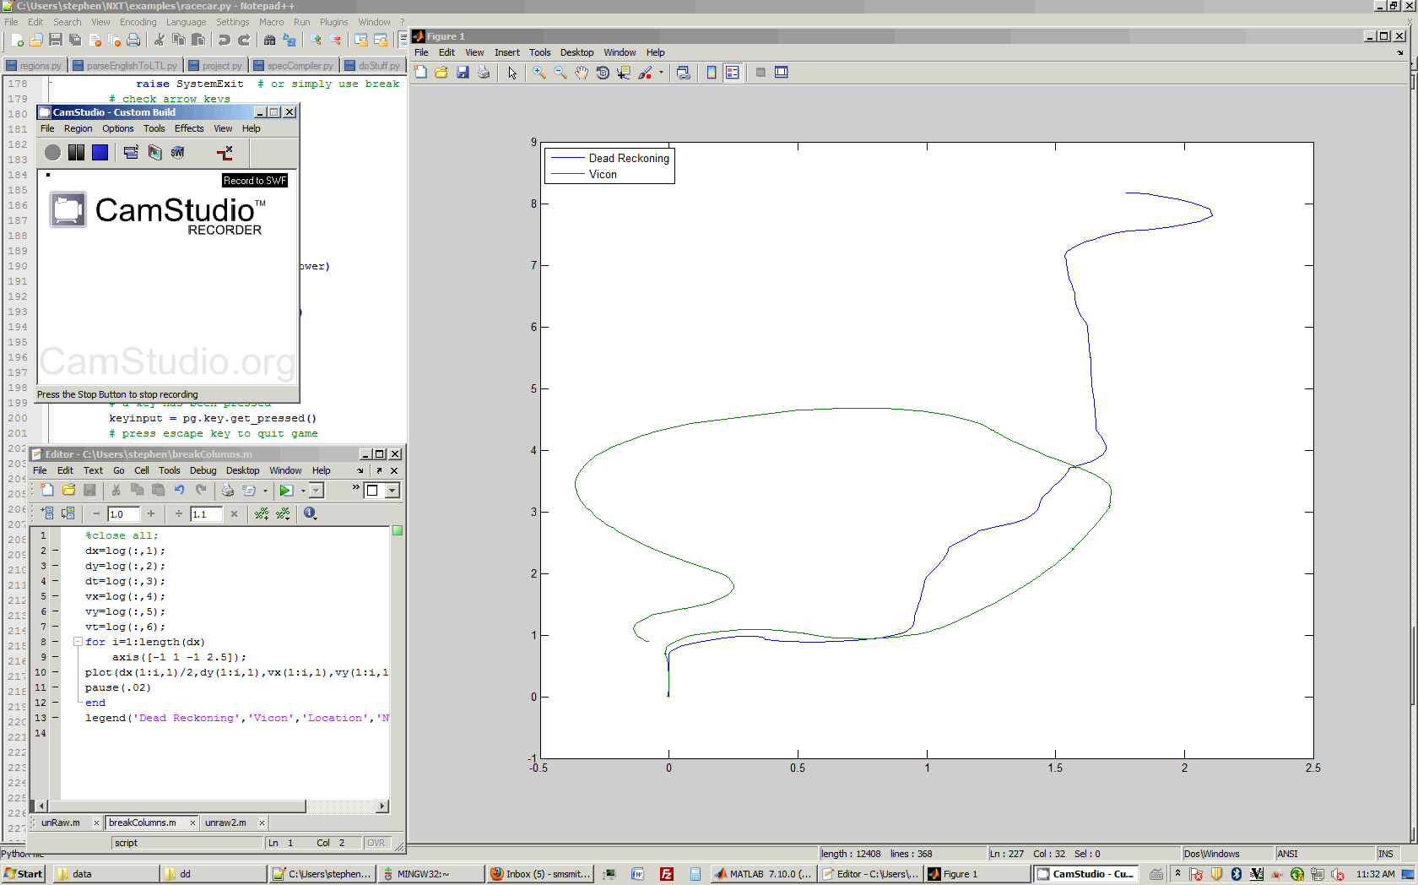
Car Style Robot

